Slide 1

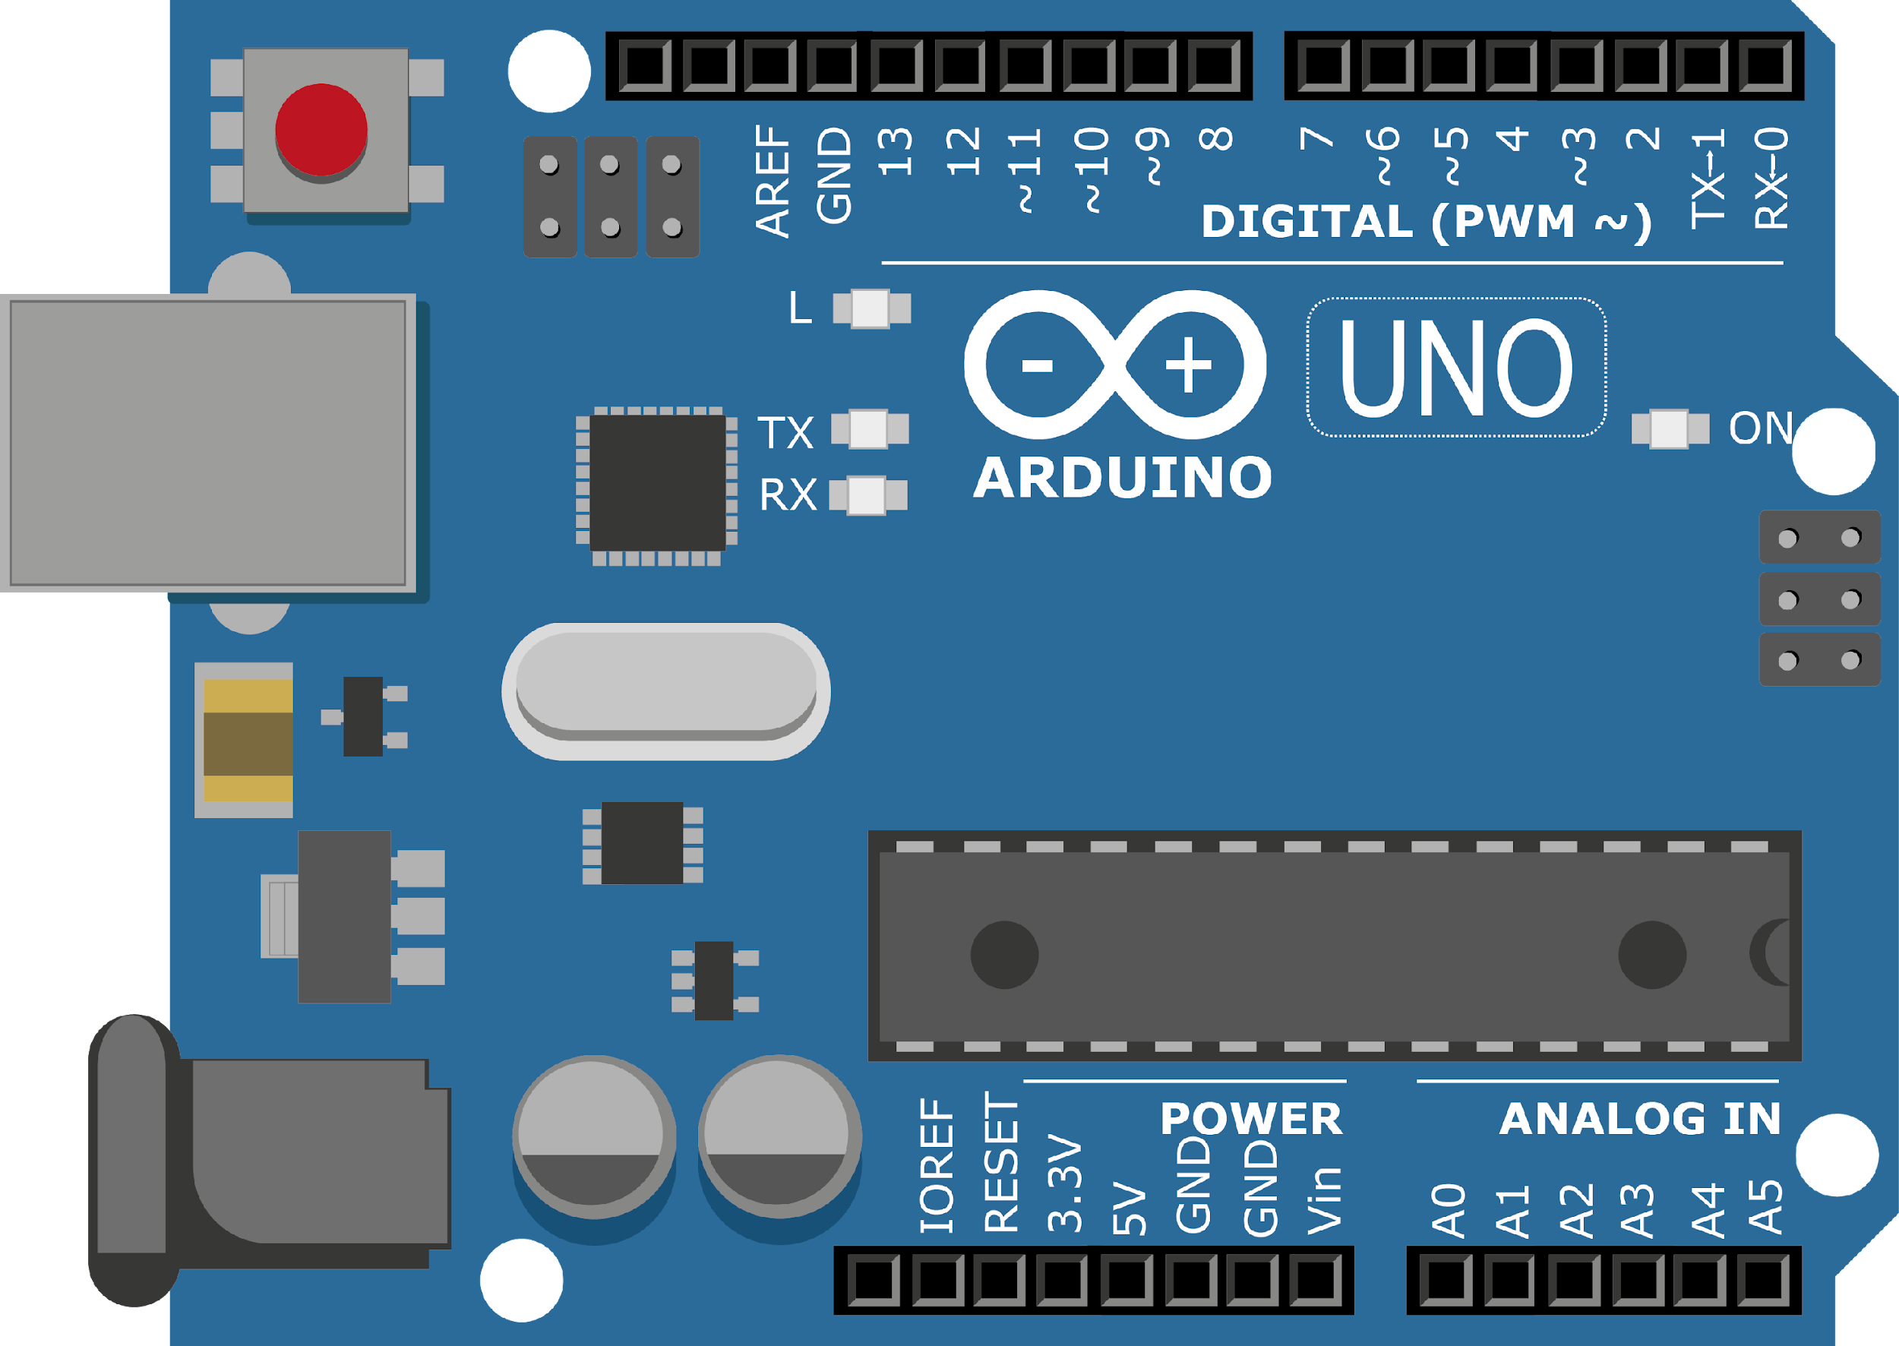
ARDUINO MASTER CLASS
04
Rat Trap | Analog I/O

Slide 2
4 AGENDA
02
03
01
Indication & Alert System
Analog I/O
Q & A

Slide 3
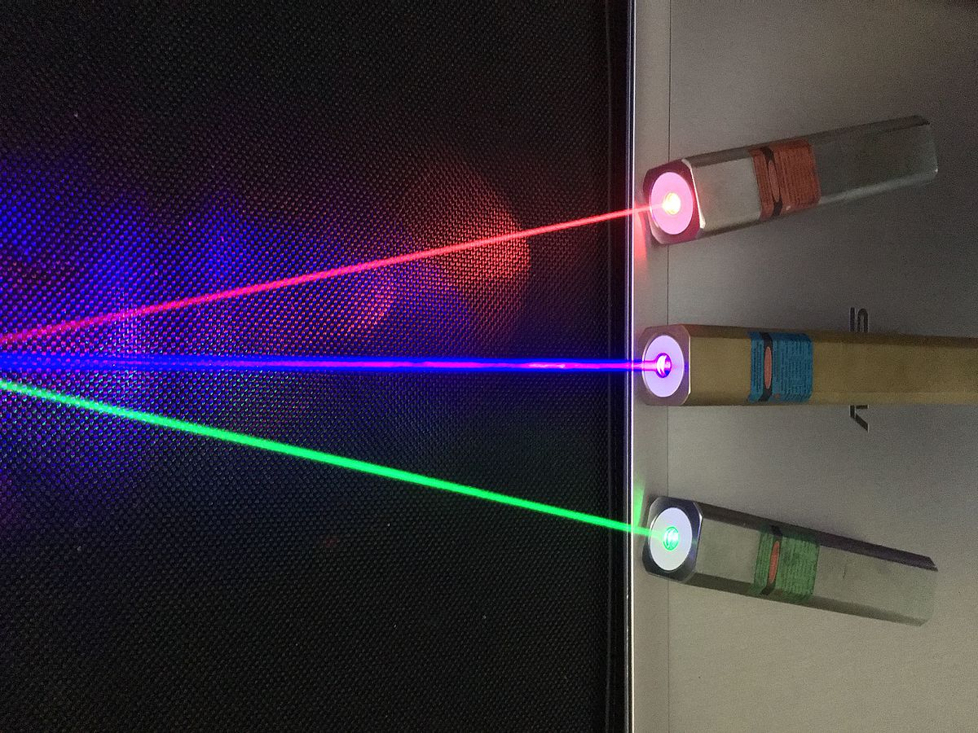
LASER
A laser is a device that emits light through a process of optical amplification based on the stimulated emission of electromagnetic radiation.
Laser, a device that stimulates atoms or molecules to emit light at particular wavelengths and amplifies that light, typically producing a very narrow beam of radiation.

Slide 4
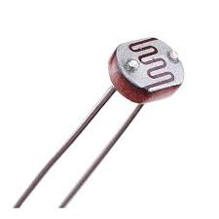
LDR - Light Dependent Resistor
A photoresistor or light dependent resistor is an electronic component that is sensitive to light. When light falls upon it, then the resistance changes.
Values of the resistance of the LDR may change over many orders of magnitude the value of the resistance falling as the level of light increases.

Slide 5
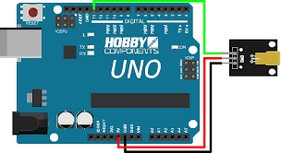
Connecting Laser Module
VCC | Ground | Data

Slide 6
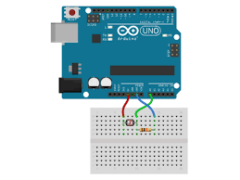
Connecting LDR
LDR & 10K Ohm (Brown, Black, Orange)

Slide 7

INTERVIEW QUESTIONS
What is the function of LDR?
If resistance is low in LDR than light is dim or bright?
How many Bit ADC is Present in Arduino?
The main purpose of a light dependent resistor is to change the brightness of a light in different weather conditions.
10 Bit ADC | It has the ability to detect 1,024 (2^10) discrete analog levels. Some microcontrollers have 8-bit ADCs (2^8 = 256 discrete levels) and some have 16-bit ADCs (2^16 = 65,536 discrete levels).
Bright

Slide 8

THANKS!

